Slide 1
WELCOME BACK!

Slide 2
ORIENTATION AGENDA
Theme for 2024-2025
Introductions
Values and Habits w/ Ms. Blackwell
Mastery Learning with Dr. Jones
PBL with Ms. Blackburn
The Widget w/ Mrs. Boldware, Mrs. Brown
Counseling Cove with Ms. H
Lunch, Who to Call, Device Policy
Bell Schedule
More Stuff!!

Slide 4
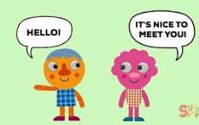
INTRODUCTIONS!!

Slide 5
ACPA VALUES

Slide 6
ACPA HABITS

Slide 7
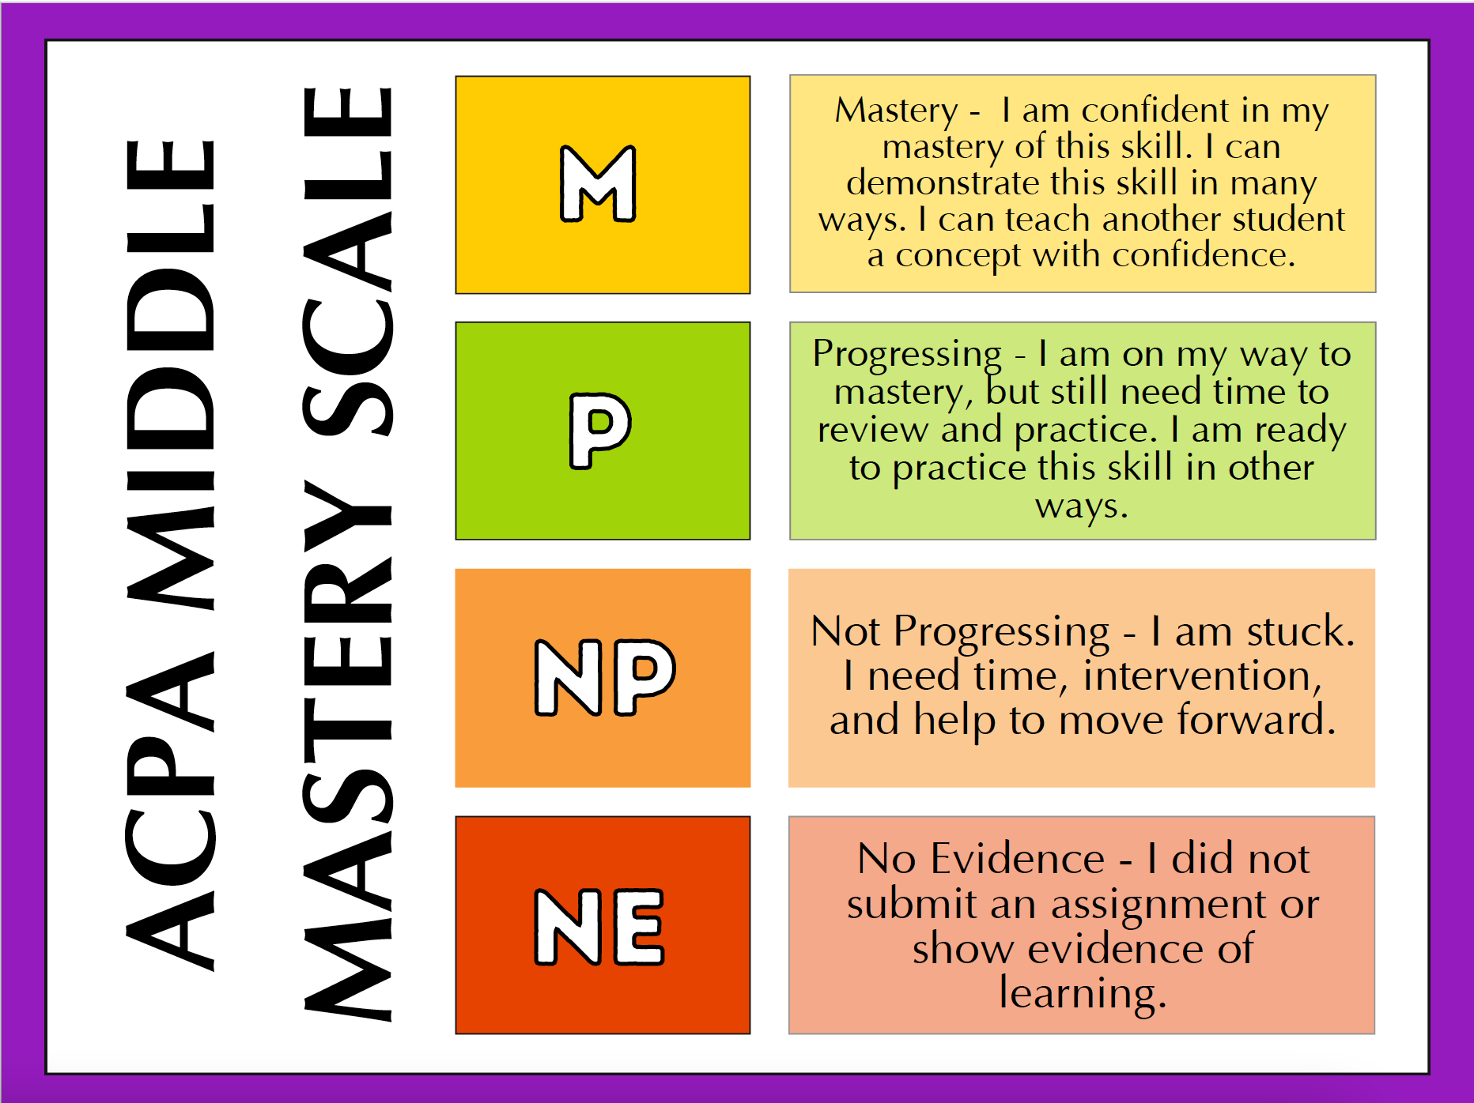
MASTERY
SCALE
GRADING

Slide 8
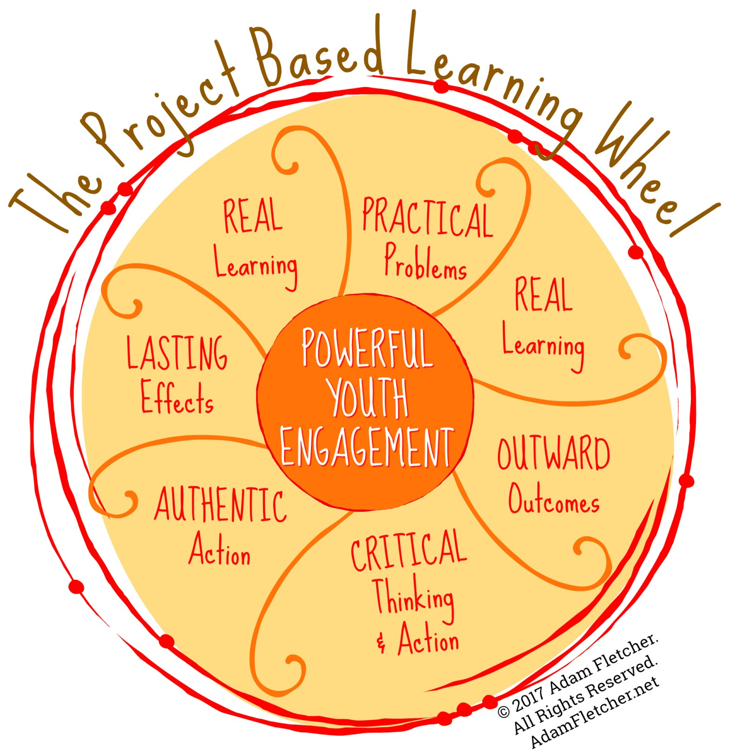
PROJECT BASED
LEARNING

Slide 9
THE WIDGET
Mrs. Brown and Mrs. Boldware

Slide 10
Counseling cove
Ms. H

Slide 11
Acpa cafe
COST:
$2.50 breakfast
$3.80 lunch
Reduced pricing:
Free breakfast
Free lunch
Payment Options:
Prepay will be available when school starts
Daily cash payment

Slide 12
WHO YOU GONNA CALL/EMAIL?
ATTENDANCE:
Emily Collins or Vivian Morrison at 614-986-9974
attendance@artcollegeprep.org
Transportation + Carpool
Sarah Silver - contact for questions silver@artcollegeprep.org

Slide 13
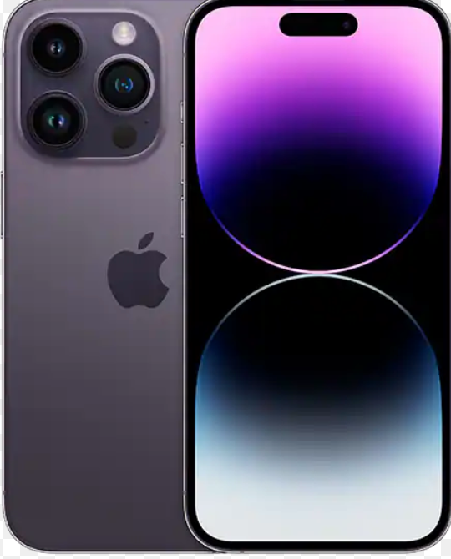
DEVICE POLICY
ACPA Middle School has a strict
NO PHONE and BLUETOOTH DEVICE policy.
From 8:55 am to 4:05 pm, their phone needs in their backpack or their locker . If they use their phone without permission, it will be confiscated and given to the principal. If it happens twice, the phone will be released only to a parent or guardian.

Slide 14
Academic Impact of Devices
Studies find that it can take students up to 20 minutes (⅓ of MS class) to refocus on what they were learning once distracted.
The existing studies provide evidence that allowing phones in the classroom negatively impacts test scores and long-term learning retention.
Research in psychology on multitasking generally finds negative effects on learning and task completion.

Slide 15
Social Emotional Impact of Devices
Surgeon General Advisory: Social Media can carry “a profound risk of harm to the mental health and well-being of children and adolescents”
Social media can affect adolescents’ self-view and interpersonal relationships through social comparison and negative interactions, including cyberbullying; moreover, social media content often involves normalization and even promotion of self-harm and suicidality among youth. (Abi-Jaoude et al., 2020)
“Smartphone and social media use in the increase in mental distress, self-injurious behaviour and suicidality among youth; there is a dose–response relationship” (Abi-Jaoude et al., 2020)

Slide 16
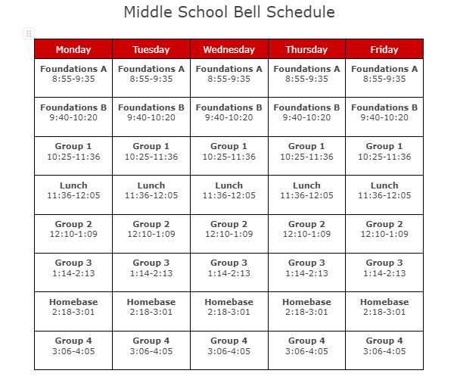

Slide 17
THINGS TO REMEMBER:
Early Dismissal Procedures
If you need to pick up your student early, you must do so in person in the Middle School Office
Make sure to bring an ID
No pick up between 3:30-4:05pm (unless approved by Ms. Blackwell in advance).
After School Program + Events
Students must be picked up by 5:15pm.
Caregivers will be charged $5 for every 5 minutes after 5:30
Caregivers must attend events with students (Open Houses, plays, performances)

Slide 18
Login Information in your Folders
Different for Students & Caregivers
View assignments and mastery levels in each of their classes.
Keeps track of submitted assignments and mastery level or completion.

Slide 19
Schoology follows your student → you will always have access to any course your child is enrolled in throughout their time at ACPA.
Caregiver Logins will be sent by Home Base Teacher
Access your Student’s learning materials, assignments and a calendar of past and upcoming events and assignments
You cannot interact in a course and you cannot view other student’s information or course participation.

Slide 20
FOUNDATIONS
WAV
Performing Arts
Physical Education / Music
Visual Art / Social Emotional Learning

Slide 21
wav

Slide 22
It’s the first day! Where do I go?
Head to the MS ELA
Grab Breakfast after 8:30 in the cafeteria to eat in the MS ELA
In other words…Middle School Students stay in the Middle School

Slide 23
Student Folders
Contains:
Bell Schedule
PowerSchool Access (Caregiver + Student)
Parents Guide to Schoology
Lunch Information
Academic + Arts Events Calendar

