Slide 1
ACPA High School
New Student & Family
Orientation
2024-2025

Slide 2
Tonight’s Agenda
ACPA Administration
Meet your teachers (by department)
Handbook
Parent Communication
Attendance
8. Transportation
9. Lunch
10. Technology
Schoology
PowerSchool
11. Upcoming events (Chalk Fest, Audition Night)

Slide 3
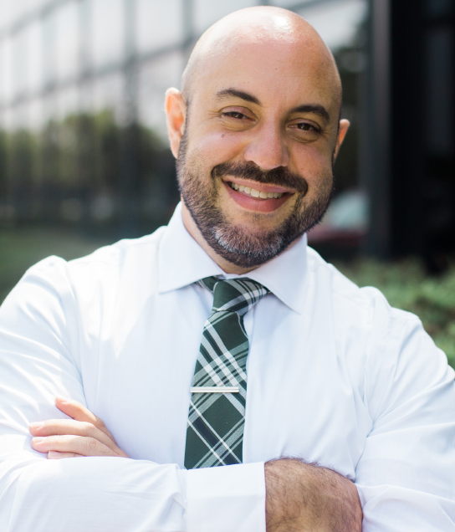
Superintendent
Tony Gatto
gatto@artcollegeprep.org

Slide 4
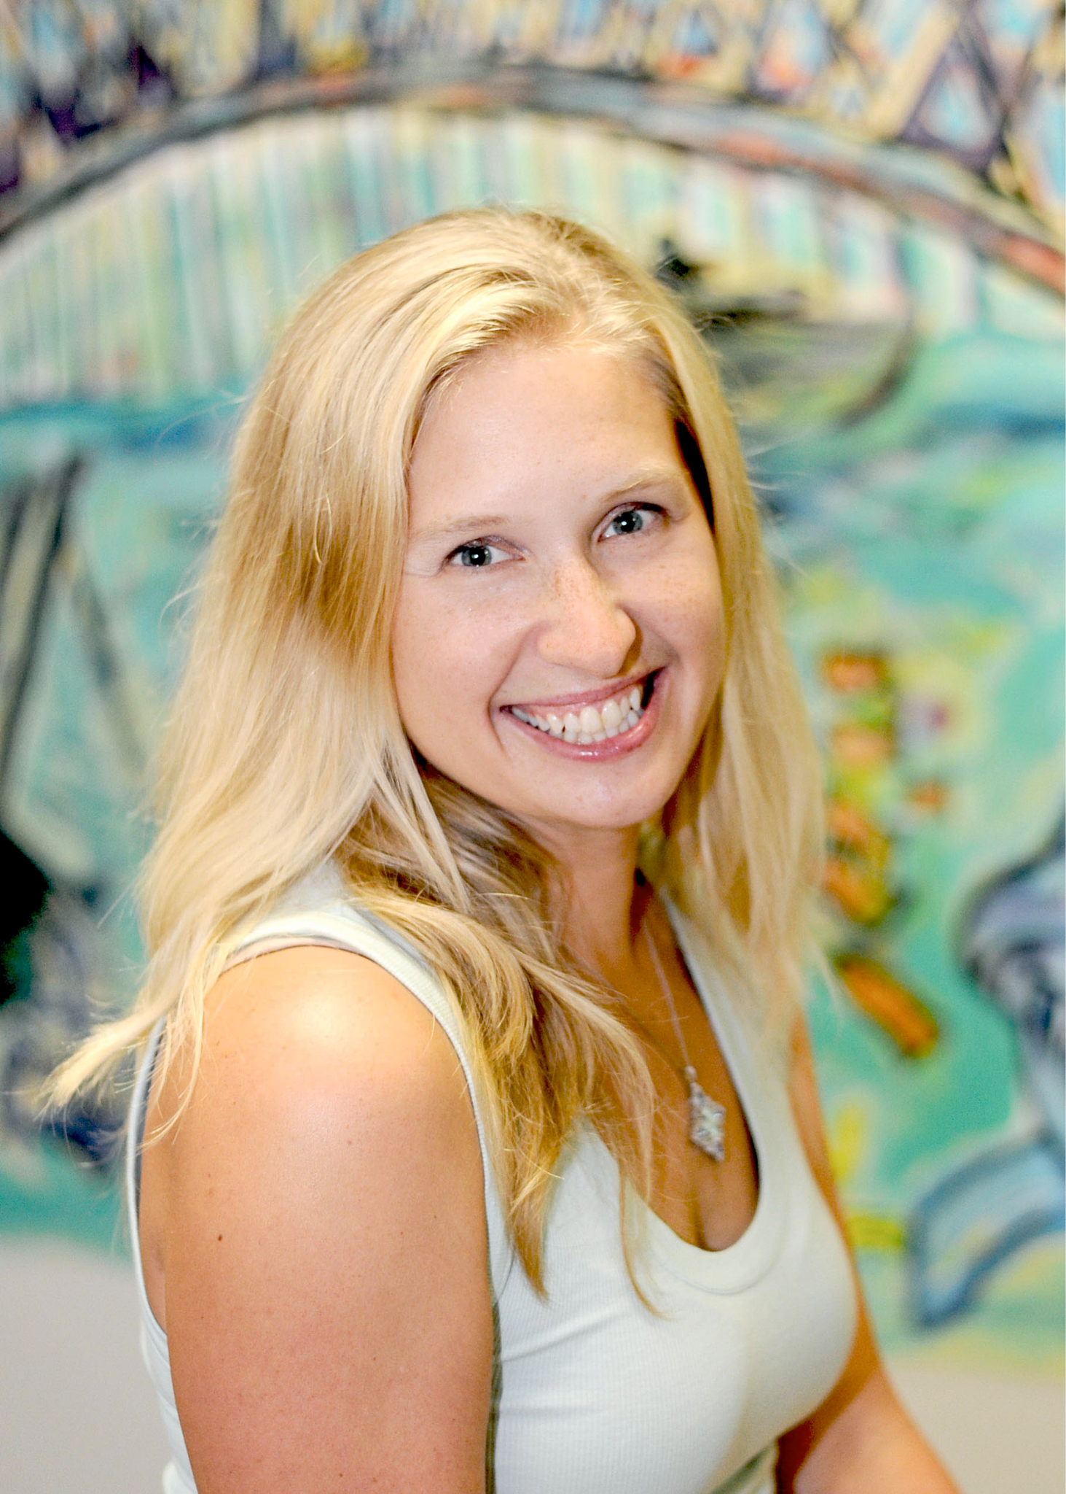
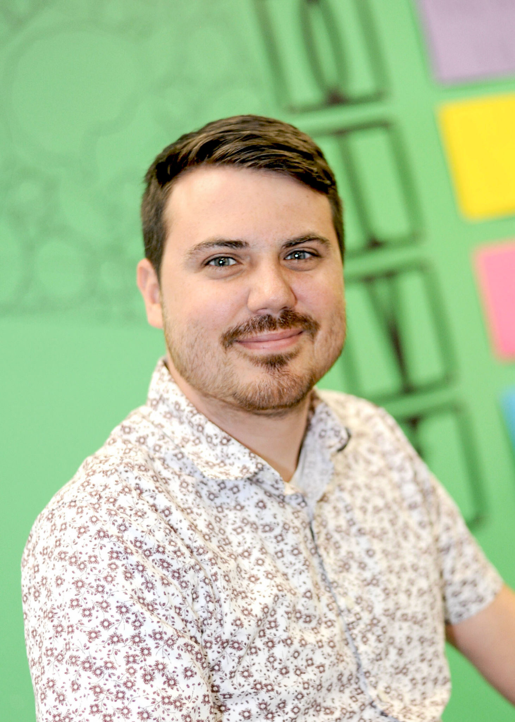
Co-Principals
Catherine McMillin
mcmillin@artcollegeprep.org
Aaron Wagner
wagner@artcollegeprep.org

Slide 5
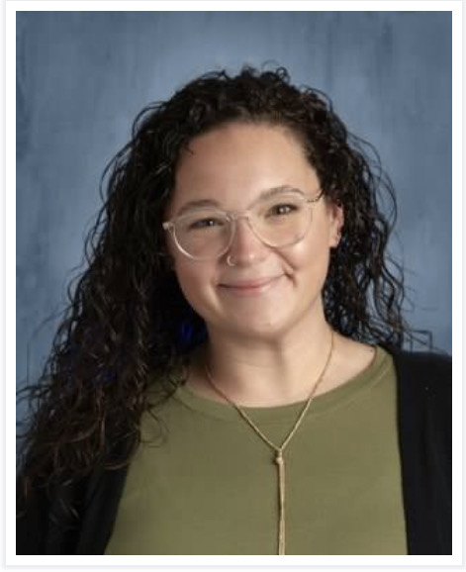
Attendance and Transportation Coordinator
Sarah Silver
silver@artcollegeprep.org

Slide 6
High School Staff

Slide 7
Our Values & Habits

Slide 8
The Student Handbook
Policies based on our ACPA Values and Habits
The Handbook is on the ACPA Website
Students will go over this in the first few weeks of school
There will be a form for families to sign once students have reviewed the handbook at the beginning of the year.

Slide 9
Cell Phone Policy
Phones are to be put away during class time.
Phones can be used before and after school and during lunch.
Parents can call into the school to relay transportation information to your student.
Studies find that it can take students up to 20 minutes (almost 1/2 of class time) to refocus on what they were learning once distracted.

Slide 10
Parent Communication
Weekly ACPA newsletter
Social media
Email for emergent events
One Call Now

Slide 11
Attendance
School starts at 8:55. Students should arrive by 8:45.
Call the school to report absences (leave a voicemail) or email attendance@artcollegeprep.org
Notify school by 10:00AM
Notes:
8:50 arrival allows students time to get settled into class and be ready when 8:55 bell rings.

Slide 12
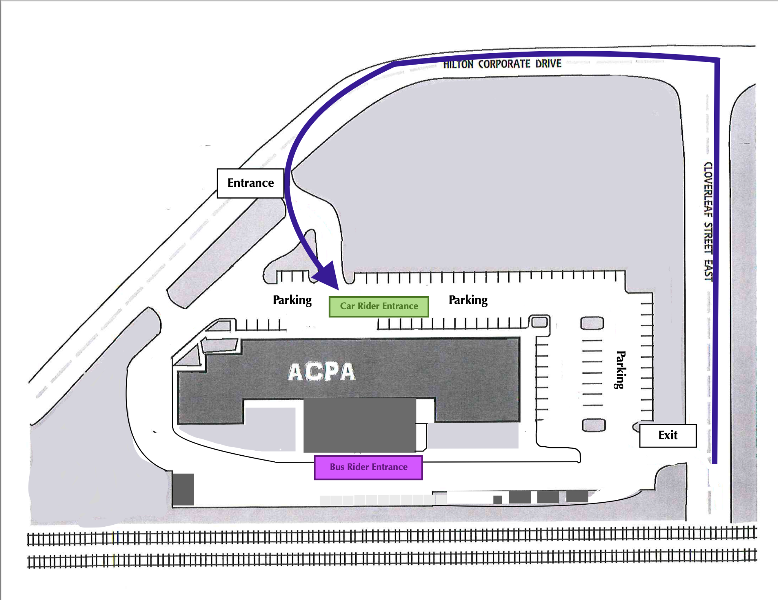
Transportation
Traffic flow
First week
Consider picking up student a few minutes after 4:05
Any busing issues should be communicated directly to the home district (late bus, missing bus, etc.) as well as ACPA
Carpool? Check the QR code for the Facebook group!
Notes:
TRAFFIC MAP

Slide 13
Leaving the Building
Students must be signed out by parent/guardian to leave campus
Parent/guardian show ID and enter the school to sign out the student
No student is to leave campus between 3:30 and 4:05.
If you have an issue or concern please reach out to Ms. Mcmillin and Mr. Wagner

Slide 14
Breakfast/Lunch
Paid
$2.50 breakfast
$3.80 lunch
Reduced pricing:
Free breakfast
Free lunch
Notes:
Are prices still the same?

Slide 15
Technology
PowerSchool
Student & Parent Gradebook Access
Videos available on the ACPA website
Schoology
Access to class materials, assignments, upcoming deadlines & groups/clubs

Slide 16
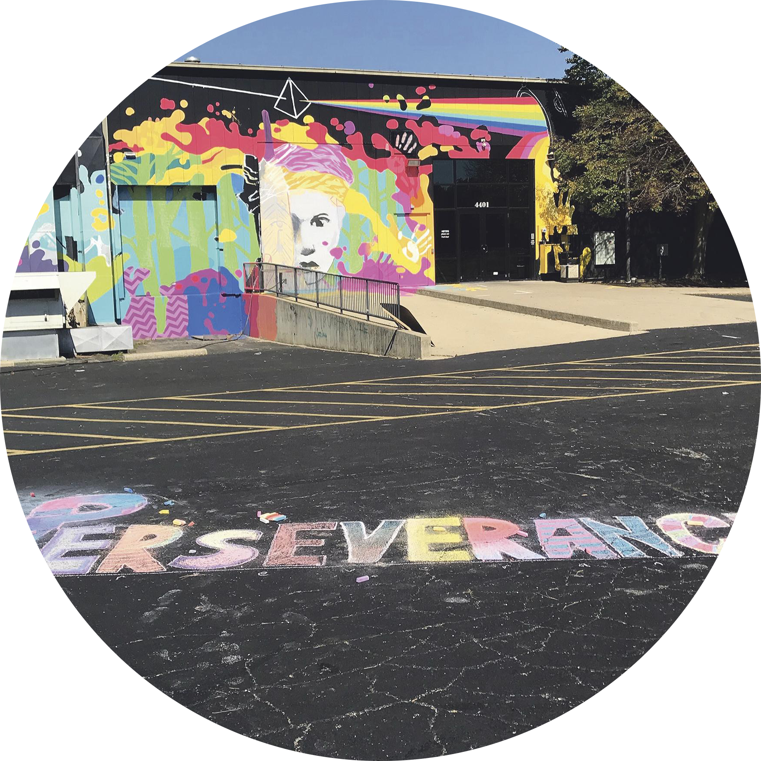
Upcoming Events
Notes:
UPDATE PICTURES

Slide 17
Notes:
UPDATE!

Slide 18
Who’s Available?
ELA
-Social Workers -Lockers
-School nurse
-Counseling
Collab
-Intervention Services
Front Office Area
-Registration
-Transportation

Slide 19
Next Steps
1. Head to the High School ELA to pick up your schedule.
2. Navigate your schedule.
3. Ask questions!
Once you have navigated the schedule and have your questions answered, head on home to get hyped and ready for school next Tuesday, August 20th!
We are excited to see you next week!

Slide 20
Thanks!
See us after for any questions

